Slide 1
NYS State 4th Grade Science
March 14th, 2017
Presenter: Rich Bebenroth

Slide 2
Parts of the exam
Day One: Performance Tasks
Day Two: Written Assessments

Slide 3
Dates
Performance Tasks: Wednesday, May 24th – Friday, June 2nd (One Day Only)
Written Assessment: Monday, June 5th (make-ups June 6th and 7th)

Slide 4
Performance Tasks
The performance task is a hands-on series of
three stations that will check students ability to
follow directions and scientific reasoning
Each student will work alone and receive fifteen minutes to finish the task. Students typically do not have any problems with the time as long as they start immediately.
Station 3
Station 2
Station 1

Slide 5
Written Science Exam
The exam is untimed
Approximately thirty multiple choice questions
Ten-fifteen short answer or fill in the blank questions.

Slide 6
Multiple Choice Example

Slide 7
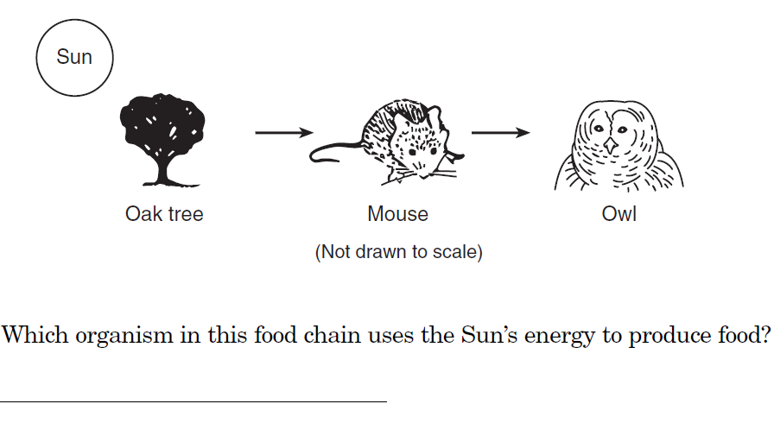
Short Answer Example

Slide 8
How to help your child prepare
The student textbook have mini experiments that the student’s may be able to do at home with common household supplies you may have. Encourage them to do them if you have the materials and explore. Inquiring minds are usually the most open minds.
The following is a game created by a 4th grade teacher that the students use and love which uses past science exam questions and follows the "Who Wants to be a Millionaire" game format. http://www.quia.com/rr/66818.html?AP_rand=2048183830

Slide 9
Historical Results

Slide 10
Additional Resources
Past written science tests with answer keys are online and can be downloaded at: http://www.nysedregents.org/Grade4/Science/home.html Please do not practice with the 2014-2016 exams as we will use them in school.
Some parents have asked for any test prep book suggestions. Though they are not needed since both the classroom teachers and I cover what needs the students are responsible to know.
Barron's New York State Grade 4 Elementary-Level Science Test by Joyce Thornton Barry and Kathleen Cahill

